Slide 1
Modern Systems Analysis
and Design
Seventh Edition
Jeffrey A. Hoffer
Joey F. George
Joseph S. Valacich
Chapter 4
Identifying and Selecting Systems Development Projects

Slide 2
Learning Objectives
Describe the project identification and selection process.
Describe corporate strategic planning and information systems planning process.
Explain the relationship between corporate strategic planning and information systems planning.
Describe how information systems planning can be used to assist in identifying and selecting systems development projects.
Chapter 4
Copyright © 2014 Pearson Education, Inc. Publishing as Prentice Hall

Slide 3
Learning Objectives (Cont.)
Analyze information systems planning matrices to determine affinity between information systems and IS projects and to forecast the impact of IS projects on business objectives.
Describe the three classes of Internet electronic commerce applications: business-to-consumer, business-to-employee, and business-to-business.
Chapter 4
Copyright © 2014 Pearson Education, Inc. Publishing as Prentice Hall

Slide 4
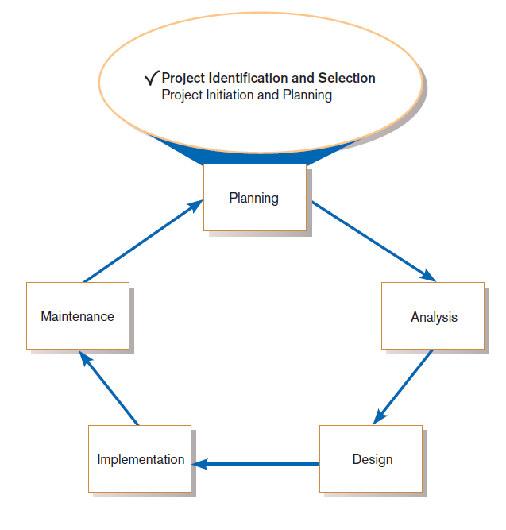
Identifying and Selecting Systems Development Projects
FIGURE 4-1
Systems development life cycle with
project identification and selection
highlighted
Three main steps:
Identifying potential development projects
Classifying and ranking IS development projects
Selecting IS development projects
Chapter 4
Copyright © 2014 Pearson Education, Inc. Publishing as Prentice Hall

Slide 5
The Process of Identifying and Selecting IS Development Projects
Identifying potential development projects
  Identification from a stakeholder group
    Each stakeholder group brings their own perspective and motivation to the IS decision.
Chapter 4
Copyright © 2014 Pearson Education, Inc. Publishing as Prentice Hall

Slide 6
The Process of Identifying and Selecting IS Development Projects (Cont.)
  Top-down source are projects identified by top management or by a diverse steering committee.
  Bottom-up source are project initiatives stemming from managers, business units, or the development group.
  The process varies substantially across organizations.
Chapter 4
Copyright © 2014 Pearson Education, Inc. Publishing as Prentice Hall

Slide 7
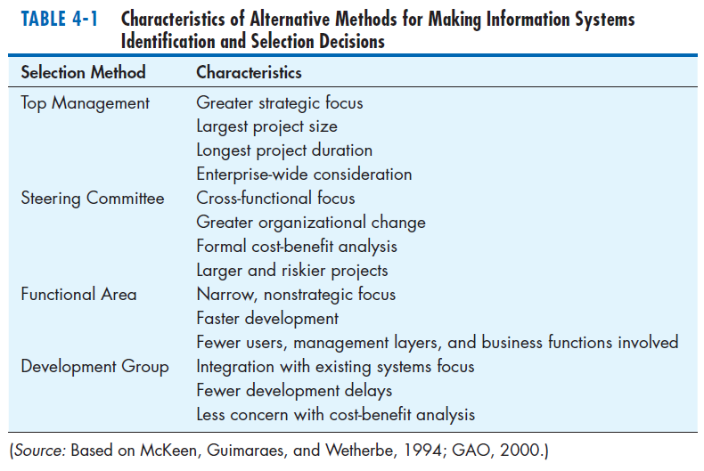
The Process of Identifying and Selecting IS Development Projects (Cont.)
Chapter 4
Copyright © 2014 Pearson Education, Inc. Publishing as Prentice Hall

Slide 8
The Process of Identifying and Selecting IS Development Projects (Cont.)
Classifying and ranking IS development projects
  Using value chain analysis or other evaluation criteria
Value chain analysis: Analyzing an organization’s activities to determine where value is added to products and/or services and the costs incurred for doing so; usually also includes a comparison with the activities, added value, and costs of other organizations for the purpose of making improvements in the organization’s operations and performance
Chapter 4
Copyright © 2014 Pearson Education, Inc. Publishing as Prentice Hall

Slide 9
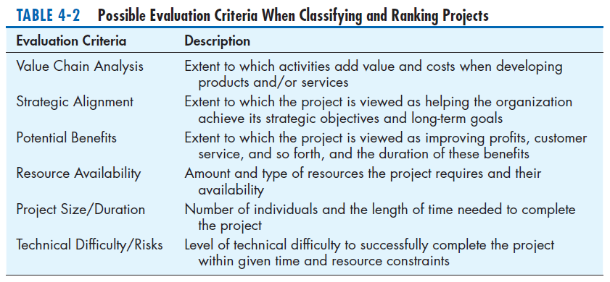
The Process of Identifying and Selecting IS Development Projects (Cont.)
Chapter 4
Copyright © 2014 Pearson Education, Inc. Publishing as Prentice Hall

Slide 10
The Process of Identifying and Selecting IS Development Projects (Cont.)
Selecting IS development projects
  Based on various factors
  Both short- and long-term projects considered
  Most likely to achieve business objectives selected
  A very important and ongoing activity
Chapter 4
Copyright © 2014 Pearson Education, Inc. Publishing as Prentice Hall

Slide 11
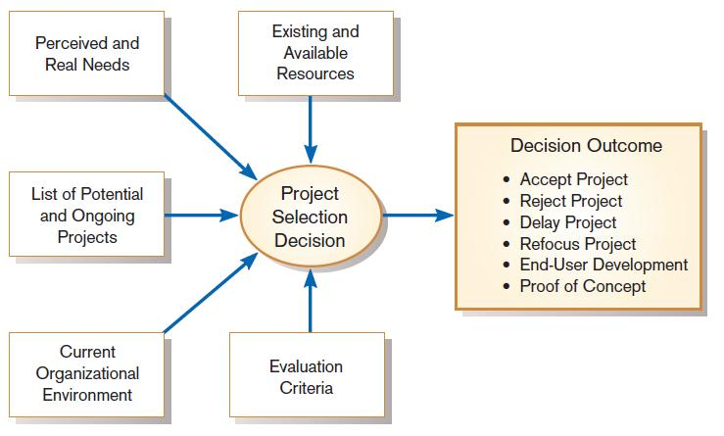
The Process of Identifying and Selecting IS Development Projects (Cont.)
FIGURE 4-3
Project selection decisions must consider numerous factors and can have numerous outcomes.
Chapter 4
Copyright © 2014 Pearson Education, Inc. Publishing as Prentice Hall

Slide 12
The Process of Identifying and Selecting IS Development Projects (Cont.)
One method for deciding among different projects or alternative designs:
  For each requirement or constraint:
  Score = weight X rating
  Each alternative: sum scores across requirements/constraints
  Alternative with highest score wins
Chapter 4
Copyright © 2014 Pearson Education, Inc. Publishing as Prentice Hall

Slide 13
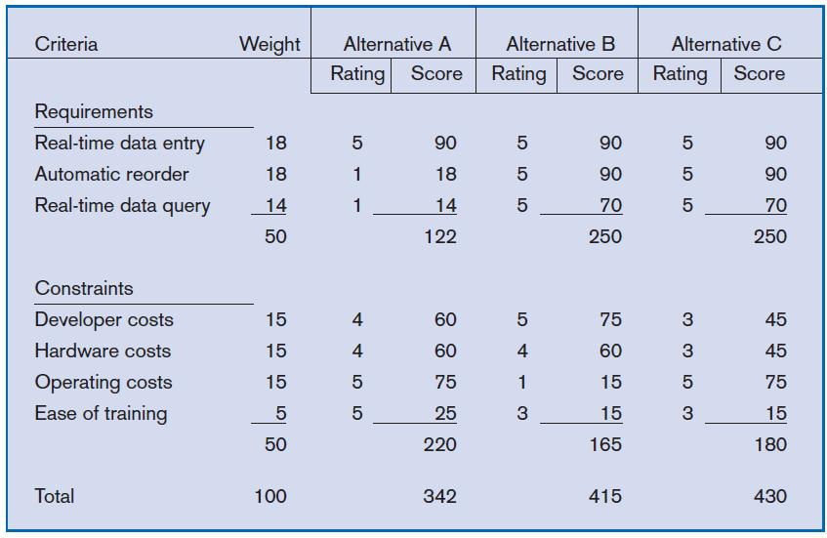
The Process of Identifying and Selecting IS Development Projects (Cont.)
FIGURE 4-4
Alternative projects and system design
decisions can be assisted using weighted
multicriteria analysis.
Chapter 4
Copyright © 2014 Pearson Education, Inc. Publishing as Prentice Hall

Slide 14
Deliverables and Outcomes
Primary deliverable from the first part of the planning phase is a schedule of specific IS development projects.
Outcome of the next part of the planning phase—project initiation and planning—is the assurance that careful consideration was given to project selection and each project can help the organization reach its goals.
Chapter 4
Copyright © 2014 Pearson Education, Inc. Publishing as Prentice Hall

Slide 15
Deliverables and Outcomes (Cont.)
Incremental commitment: a strategy in systems analysis and design in which the project is reviewed after each phase and continuation of the project is rejustified
Chapter 4
Copyright © 2014 Pearson Education, Inc. Publishing as Prentice Hall

Slide 16
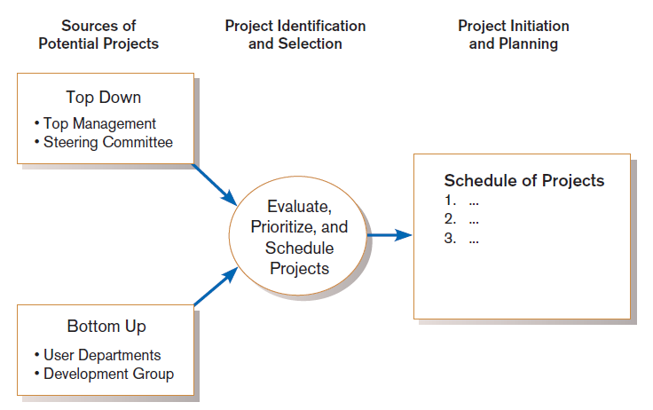
Deliverables and Outcomes (Cont.)
Figure 4-5
Information systems development projects come from both top-down and bottom-up initiatives.
Chapter 4
Copyright © 2014 Pearson Education, Inc. Publishing as Prentice Hall

Slide 17
Electronic Commerce Applications and Internet Basics
Internet: a large worldwide network of networks that use a common protocol to communicate with each other
Electronic Commerce (EC): Internet-based communication to support day-to-day business activities
Business-to-consumer (B2C): electronic commerce between businesses and consumers
Chapter 4
Copyright © 2014 Pearson Education, Inc. Publishing as Prentice Hall

Slide 18
Electronic Commerce Applications and Internet Basics (Cont.)
Business-to-business (B2B): electronic commerce between business partners, such as suppliers and intermediaries
Business-to-employee (B2E): electronic commerce between businesses and their employees
Electronic data interchange (EDI): the use of telecommunications technologies to directly transfer business documents between organizations
Chapter 4
Copyright © 2014 Pearson Education, Inc. Publishing as Prentice Hall

Slide 19
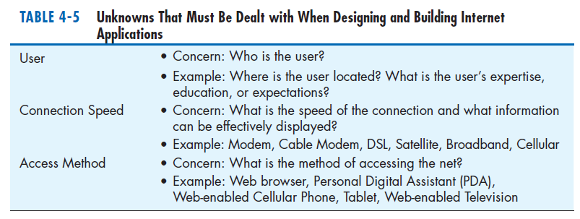
Electronic Commerce Applications and Internet Basics (Cont.)
Chapter 4
Copyright © 2014 Pearson Education, Inc. Publishing as Prentice Hall

Slide 20
The END
Chapter 4
Copyright © 2014 Pearson Education, Inc. Publishing as Prentice Hall

